Slide 1

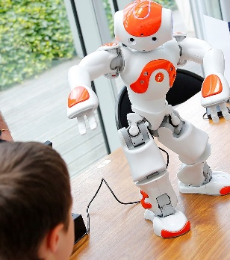
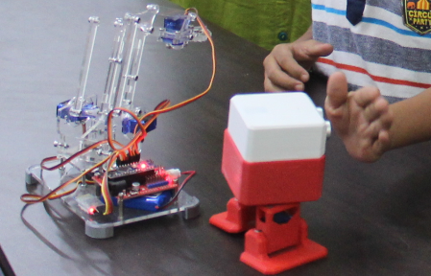
Seed The Future Entrepreneurs
Program for Schools

Slide 2
Seed The Future Entrepreneurs Program
School Name: Blue Ridge Public School
Name of your pseudo start-up : SAMĀNĪTA
#SeedTheFutureEntrepreneurs

Slide 3
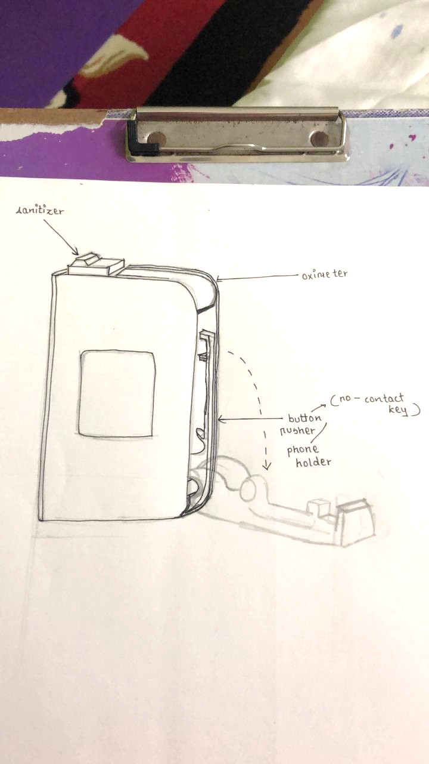
Dream Product your start-up aims to launch
Product Name: Power Kit – Safety in your pocket
What will be the key features of this product:
  Oximeter
  Infrared thermometer
  Mask holder
  Sanitizer
  Contactless key/phone holder
  Compact and portable
Who would be the targeted end-users / customers of your product (for whom it will be useful):
  Households with vulnerable people who need an affordable precautionary kit.
  People who would want to go an extra mile to ensure their own safety and the safety and good health of their loved ones.
Provide if possible any images, sketch of how the product would look like
#SeedTheFutureEntrepreneurs

Slide 4

Objective
Explain the purpose of choosing this product and how is it going to help in real world scenarios? Explain how this is a unique Idea / product for you?
  Due to the current pandemic, we wanted to create a product that would assist us to take all precautionary measures to stay safe.
  All the required medical equipment needed - in one place !
  Customizable, thus can be used even after the pandemic for different needs. We are working on different versions of the same.
Reasons why you chose the product you have chosen to launch or reasons why other options were not considered:
  Will help the community be alert
  Given the current situation, there is a huge market
  According to the law of demand, higher demand means higher supply. As there is a high demand of the product there will be a higher supply and hence a higher profit.
  Customizable
  Compact and can be carried everywhere.
#SeedTheFutureEntrepreneurs

Slide 5
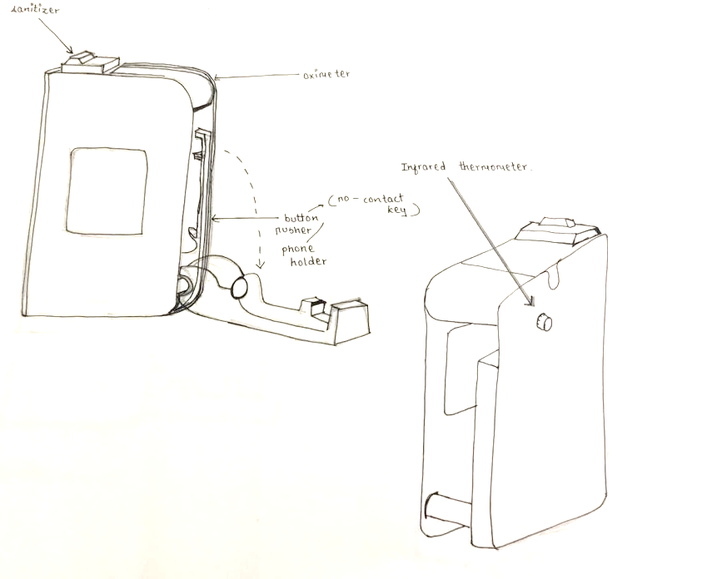
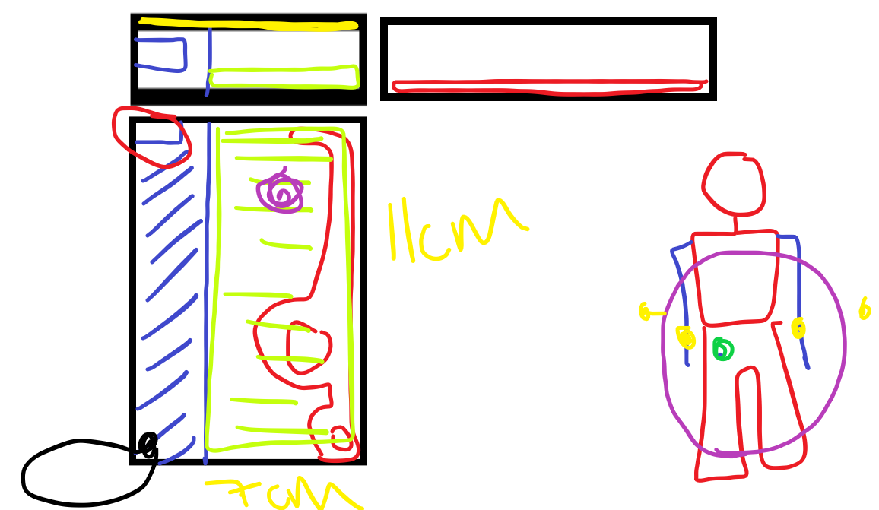
Images/Reference Pictures, Reference information
of your selected product
#SeedTheFutureEntrepreneurs

Slide 6
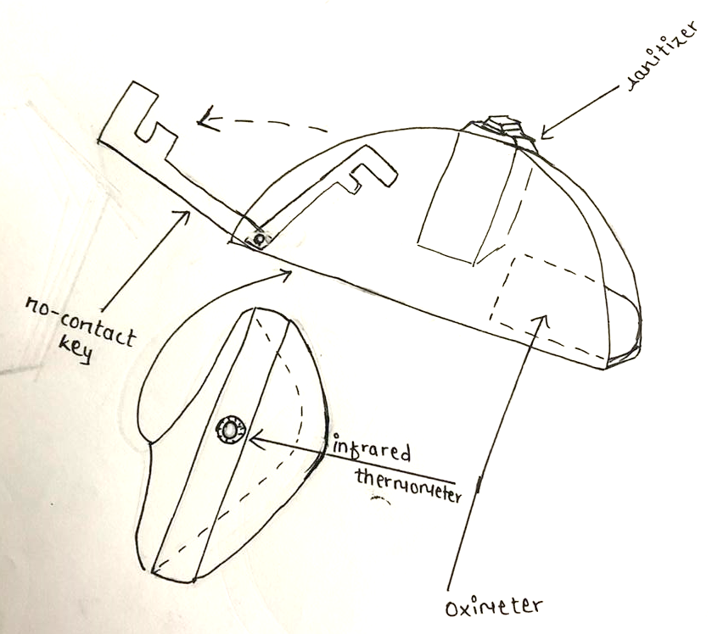
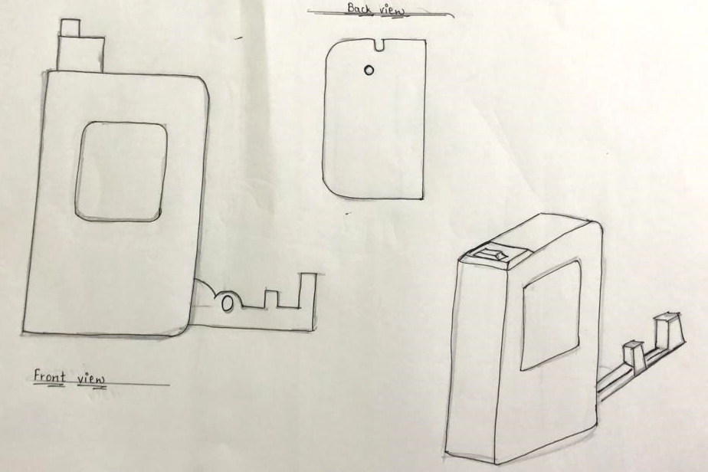
Images/different versions of the product

Slide 7
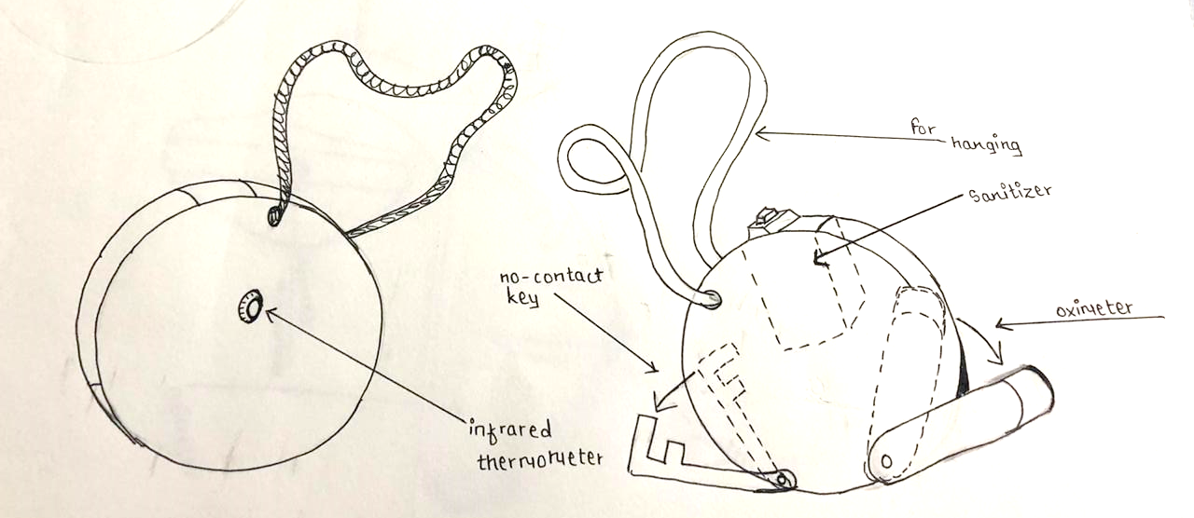
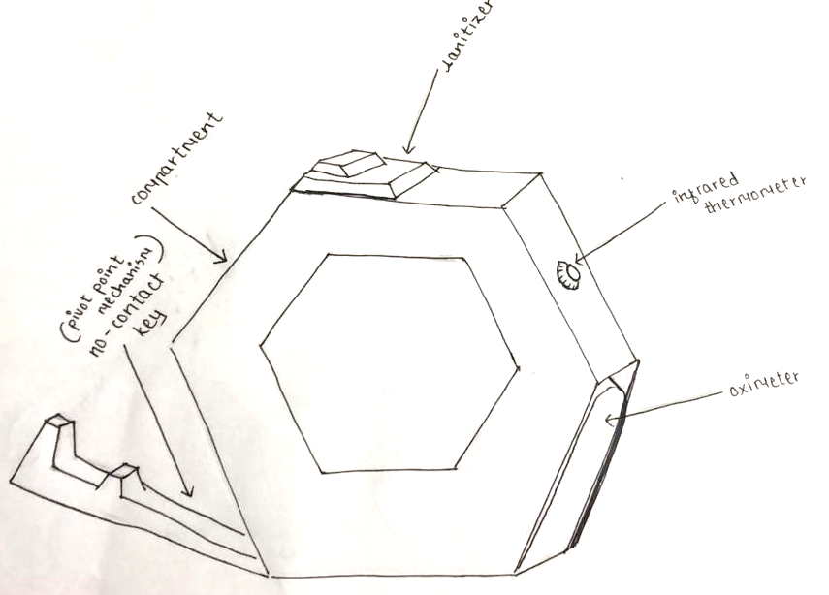
Images/different versions of the product

Slide 8
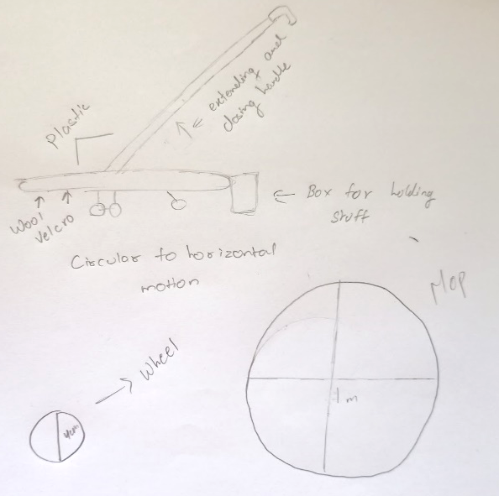
Other Options explored for your Dream Product
List which other product ideas you explored:
  Portable first aid kit
  Smart eye
  Universal automated bracket
  Manual vacuum cleaner
  3D customized table
  Hassle-free kitchen storage
Manual Vacuum Cleaner
Provide if possible any images, sketch of how the product would look like
#SeedTheFutureEntrepreneurs

Slide 9
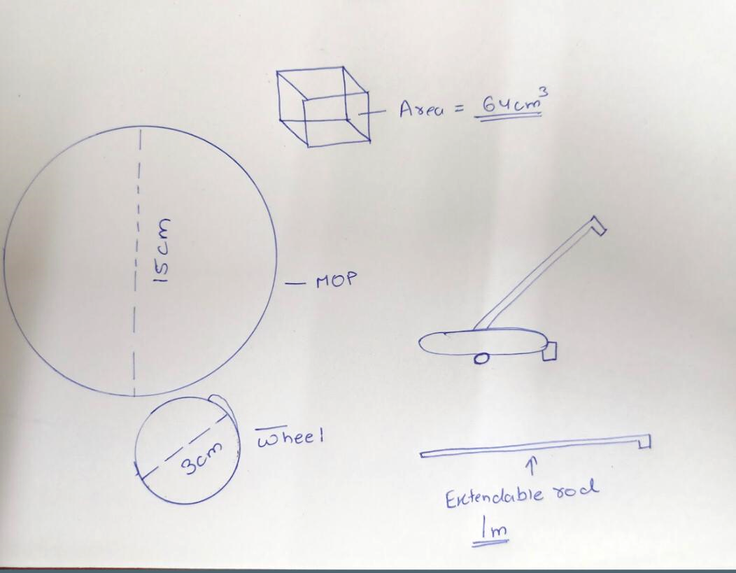
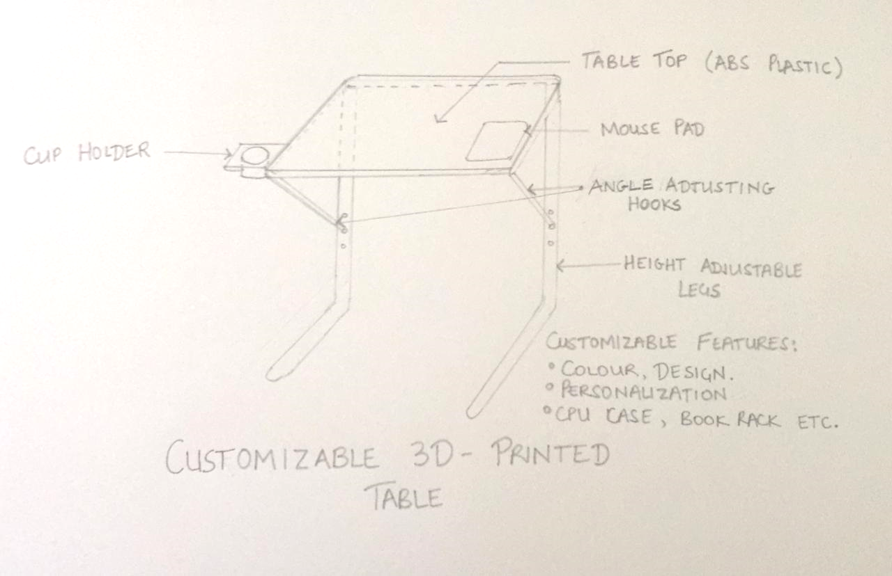
Ideas we didn’t choose-manual vacuum cleaner,
3D table
Mechanically Advanced Pilot
3D Customised Table

Slide 10
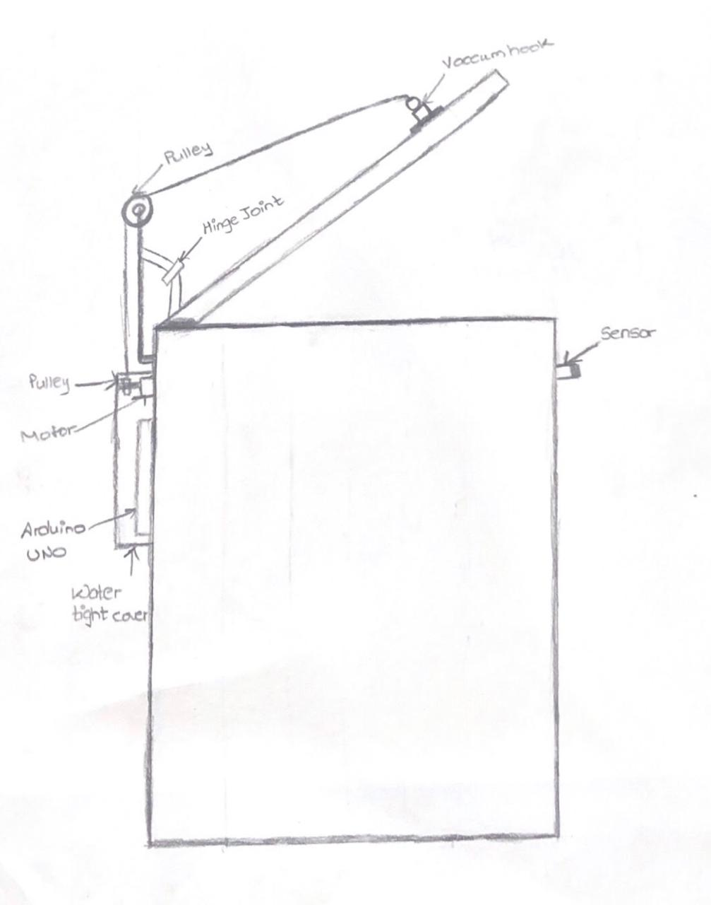
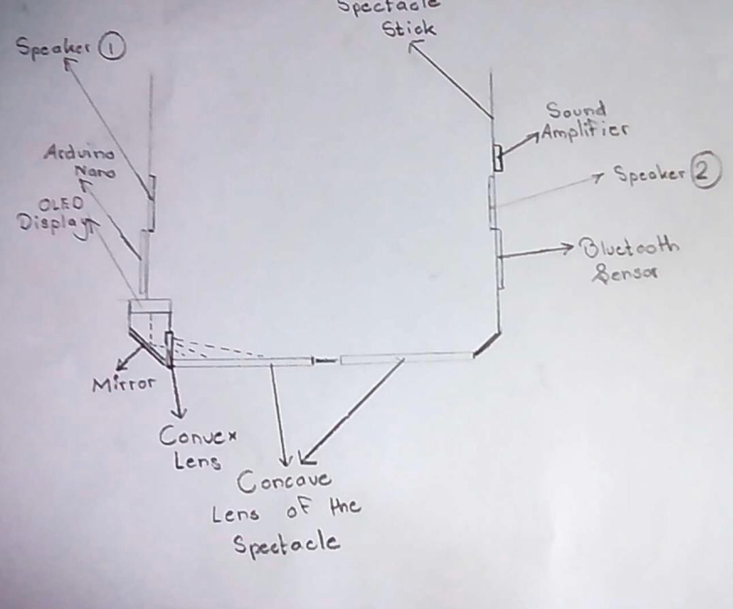
Ideas we didn’t choose-universal automated bracket, smart eye
Automated Bracket
Smart Eye

Slide 11
Other Options explored for your Dream Product
Reasons why those options were not considered:
  Portable first aid kit: Wasn’t a business centric idea nor did it have a solid base
  Smart eye: Not cost effective, was going over the budget. Wouldn’t guarantee profits
  Universal automated bracket: wasn’t feasible. Maintenance would go over the budget
  Manual vacuum cleaner: Product idea wasn’t concrete enough for 3d printing
  3D customized table: Not practical and didn’t have a large target audience nor was it cost effective
  Hassle-free kitchen storage: Wasn’t original, multiple versions of the same are already prevalent.
#SeedTheFutureEntrepreneurs

Slide 12

Seed The Future Entrepreneurs
Program for Schools

